Slide 1
Forecasting Cryptocurrency Price Trends Using ARIMA and LSTM
HARIDEEP AEPURI
MSDS Practicum II

Slide 2
Introduction
Forecasting cryptocurrency prices is challenging because bitcoin prices will change rapidly due to market demands and external factors.
This project focuses on predicting bitcoin close prices using 1-minute interval data
This study compares both traditional time series models and deep learning models
Explores external market indicator behavior over BTC data
ARIMA
Prophet
LSTM Univariate
LSTM Multivariate
ARIMA+LSTM
Hybrid

Slide 3
Problem Statement
Bitcoin prices are highly volatile and prices can change rapidly over the time which makes the price prediction challenging
The traditional methods are struggle to capture the sudden changes and high volatility.
There is a need to evaluate the models which can handle both trend and fluctuations
This project also checks whether the external market like Gold, NASDAQ, and US dollar index will improve bitcoin prediction
Bitcoin Prices
Prediction challenging
Traditional methods
Best model

Slide 4
Data Collection and cleaning
Data collected from Binance API
UNIX timestamp conversion of data to date and time format
Converted the variables like OHLC and volume to numeric format and removed the unnecessary columns
Checked for duplicate and missing values in data and prepared data for ready for model training
Resampled 1-minute BTC Interval to daily close price for external market indicators
Aligned BTC daily close prices with external market indicators
86,341
One –minute interval
60 Days
Jan 30-March 31
5 Fields
Open, High, Low, close, volume

Slide 5
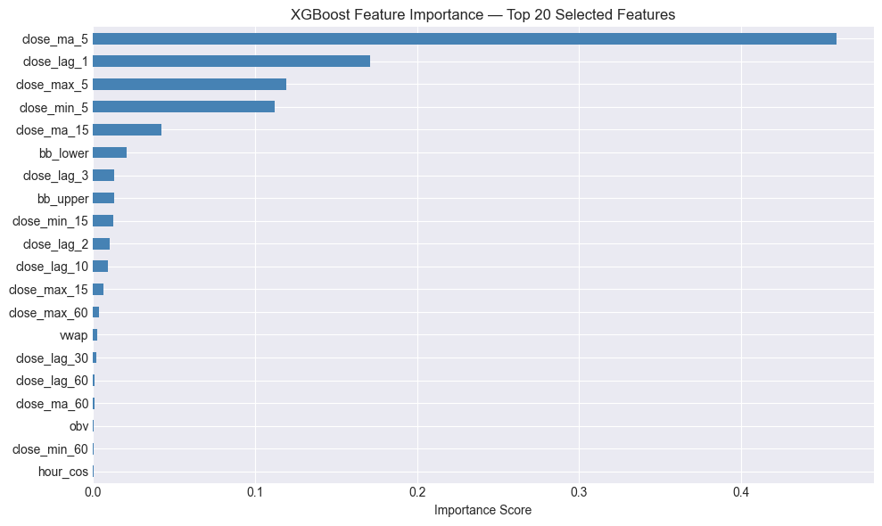
Feature Engineering
Lag based features are created for capturing the previous bitcoin price pattern movements
Created the rolling statistical like moving averages, volatility measurements which helps model to capture short term and long-term trends
To improve the market trends and momentum learning technical indicators are added
To select the top important features XGBoost was applied as feature selection

Slide 6
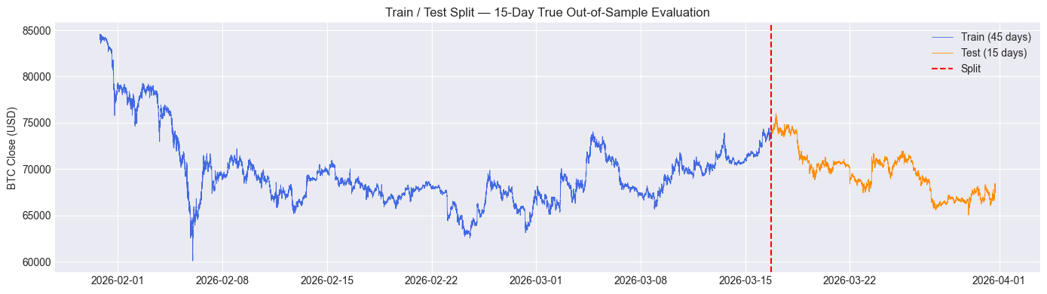
Train/Test split
The Dataset has 86,341 one-minute records
45 days from January 30 ,2026 to march 16 , 2026 considered as training set
15 days from march 16, 2026 to march 31, 2026 as test data
64,741 training observations and 21,600 testing observations
The test set was kept as true out-of-sample data for final model evaluation.

Slide 7
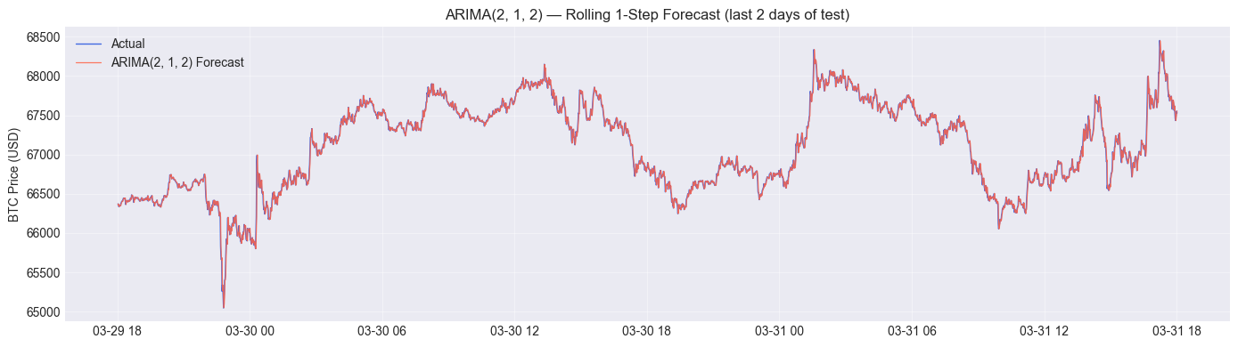
ARIMA Training and Prediction Results
ARIMA p,d,q=(2,1,2) was selected as final model using auto_arima
Model was trained on 45 days training set and 1 step rolling ahead prediction was applied on 15- day test set
ARIMA produced MAE $30.18 , RMSE 46.46 ,MAPE =0.0433% and directional accuracy =49.6

Slide 8
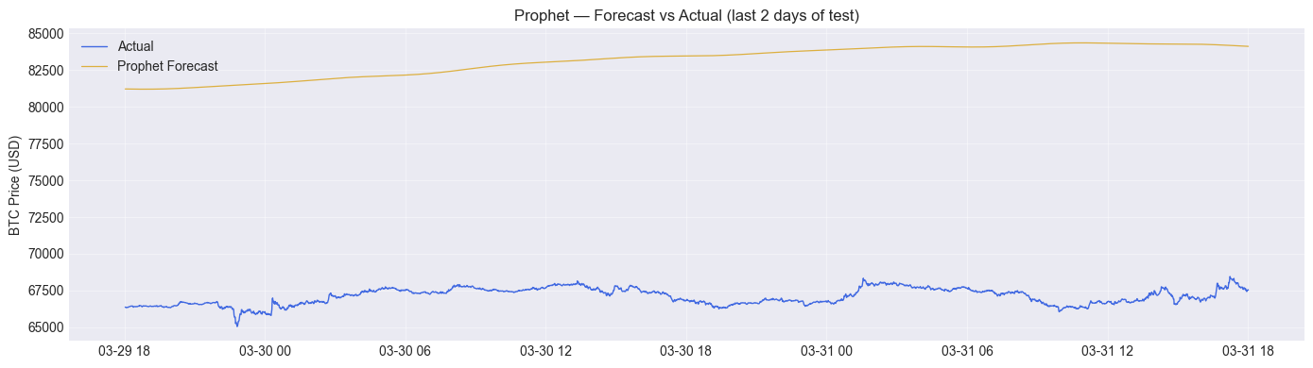
Prophet Model
Model was trained using BTC closed price with timestamp as input
Model was configured with daily and weekly seasonality and tested on 15-day test set
MAE : $ 8,897.93, RMSE : $ 10,155.09, MAPE : 13.0135% and Dir. Acc : 50.1%
This happened because one-minute Bitcoin data does not have stable seasonal patterns.
The results shows that one-minute bitcoin data does not have stable seasonal patterns

Slide 9
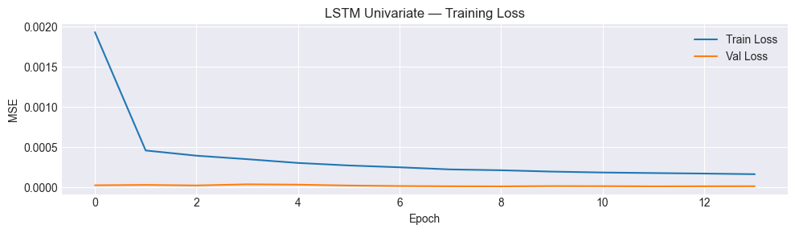
Univariate LSTM Implementation
The MinMaxScaler normalization was applied to make the large bitcoin prices on same range which helps LSTM to learn effectively
Created a sequential samples using 60-step sliding window to predict the next price movements
Used two LSTM layers 100 hidden units in first layer and 50 hidden units in second layer
Tanh activation which converts on range of -1 and 1 which helps LSTM to learn non linear complex patterns
To reduce overfitting added a dropout regularization (0.1)
Trained for up to 25 epochs using rolling sequence forecasting
From graph both training and validation loss are decreasing which indicates not overfitting

Slide 10
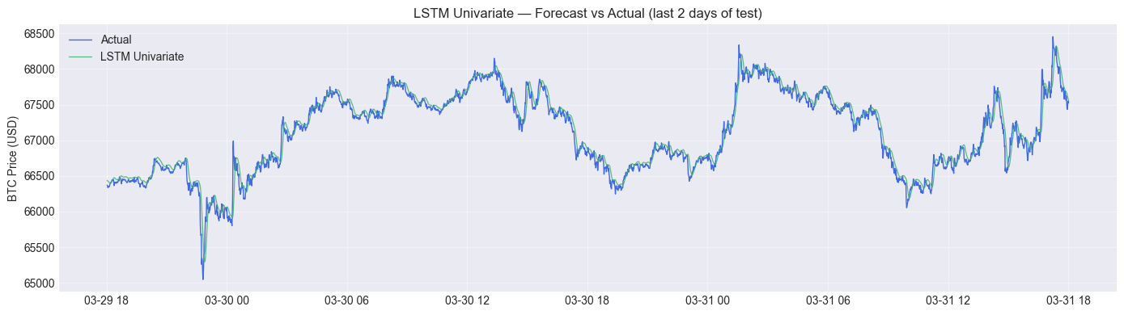
Univariate LSTM Actual vs Predicted
The LSTM prediction follows the actual bitcoin prices very closely which is capturing the non-linear market behavior.
LSTM follows the trend but not capturing the rapid fluctuations fully
Slight prediction lag was observed during sudden price spikes and rapid market changes.
Model is learned well in capturing upwards and downwards trend but struggled to capture many spikes
LSTM Univariate: MAE = 64.52$ , RMSE = 96.26 MAPE = 0.0928% Dir. Accuracy= 48.3%

Slide 11
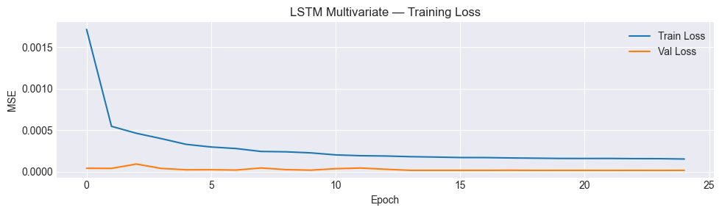
Multivariate LSTM Implementation
Used the top selected feature engineering features by XGBoost such as lag features , moving averages , volatility indicators and technical indicators
The model learned using multiple market related features which helps Multivariate LSTM learn better then Univariate LSTM

Slide 12
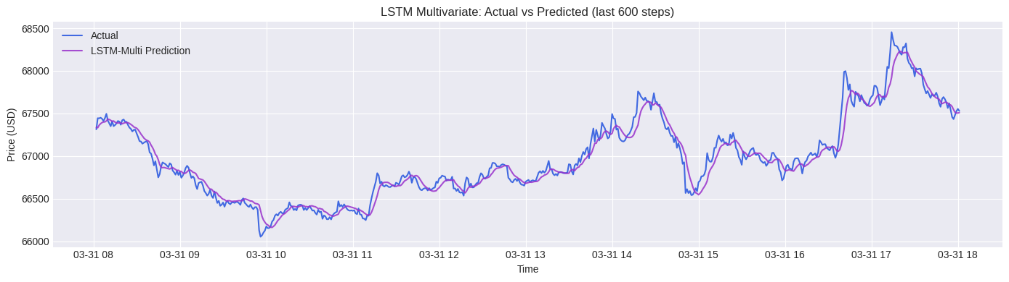
Multivariate LSTM Actual vs Predicted
Multivariate LSTM used the top 20 XGBoost selected features
Predictions follows the actual BTC closely and capturing the general up and down movements but missing some sharp spikes
Even model uses additional technical indicators but performance is not improved then univariate LSTM
Additional features added complexity and noise apart from strong predictive signal for one-minute btc forecasting
LSTM Multivariate: MAE = $ 68.91 RMSE = 103.54 MAPE = 0.0990% Dir. Accuracy= 48.8%

Slide 13
Hybrid Model ARIMA+LSTM
Bitcoin price
First ARIMA model was used for linear bitcoin prices
Extracted the ARIMA residuals to identify errors not captured by statistical model
By using 3-sigma method residual outliers are clipped and residuals are scaled between -1 and 1 for stable LSTM learning
LSTM model was trained a 60-step residual was created
LSTM was trained on ARIMA residuals to learn non linear patterns
ARIMA Forecast
Residual Errors
LSTM Residual Learning
Hybrid Forecast

Slide 14
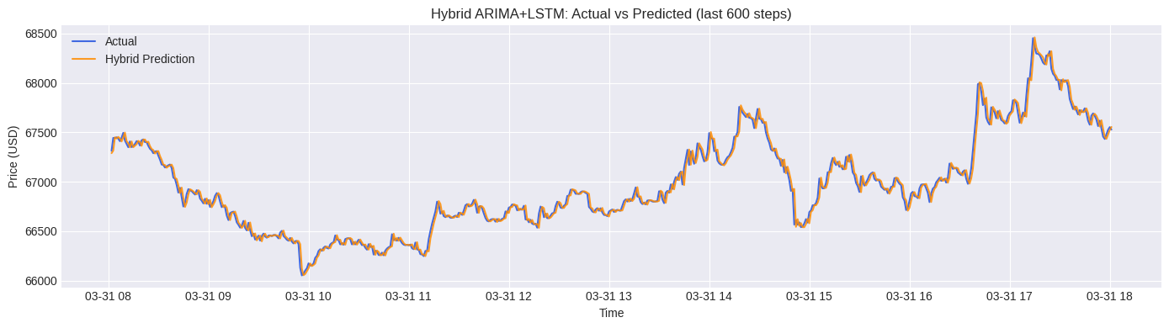
Hybrid model Actual vs Predicted
Hybrid model is following the overall bitcoin prices very closely but performance is similar to ARIMA
ARIMA model captures most of useful patterns and LSTM component of the Hybrid model did not learn additional meaningful patterns from the ARIMA residuals
Very limited non-linear patterns are left for LSTM component
Hybrid ARIMA+LSTM: MAE = $ 30.21, RMSE = 46.48 MAPE = 0.0433% Dir. Accuracy= 49.6%

Slide 15
Model’s comparison
The ARIMA achieved a low error values and better directional accuracy
Hybrid model achieved a stable performance combining ARIMA and LSTM
univariate LSTM performs slightly better than Multivariate across evaluation metrics and directional accuracy is better for multivariate
Model | MAE($) | RMSE($) | MAPE($) | Dir Acc%
ARIMA | 30.18 | 46.46 | 0.0433 | 49.6
Hybrid model | 30.21 | 46.48 | 0.0433 | 49.6
LSTM univariate | 64.52 | 96.26 | 0.0928 | 48.3
LSTM Multivariate | 68.91 | 103.54 | 0.0990 | 48.8
Prophet | 8,897.93 | 10,155.09 | 13.0135 | 50.1%

Slide 16
Walk-Forward cross-validation
Walk-forward cross validation was used to check the stability of ARIMA across different time windows
Four folds each fold has 8,634 rows which is 10% of data in each fold
At each fold model trained on past data to test on next unseen data
Training windows was expanded on each fold that allows model to learn more from historical data
ARIMA MAE is improved from fold 1 37.28 to fold 4 26.80
The walk forward validation results show that ARIMA model performances are stable across time and model is not dependent on single train test split
Fold | MAE($)
1 | 37.28
2 | 31.24
3 | 30.75
4 | 26.80

Slide 17
Multi-Horizon Forecast Analysis
Tested Multi-Horizon for ARIMA and LSTM at different levels like 1,5,10,and 30 minutes
Used 60-minute window for LSTM
Both models showed monotonically increasing MAE with horizon
ARIMA maintained a consistent advantage over LSTM at all horizons. At H = 1, ARIMA’s MAE was approximately 48% of LSTM’s; at H = 30, it was approximately 77% of LSTM’s,
ARIMA performed better then LSTM
ARIMA error is very small when it compare on overall bitcoin prices
H | ARIMA(MAE) | LSTM(MAE)
1 | 32.96 | 69.36
5 | 72.76 | 87.18
10 | 100.35 | 126.28
30 | 166.10 | 215.81

Slide 18
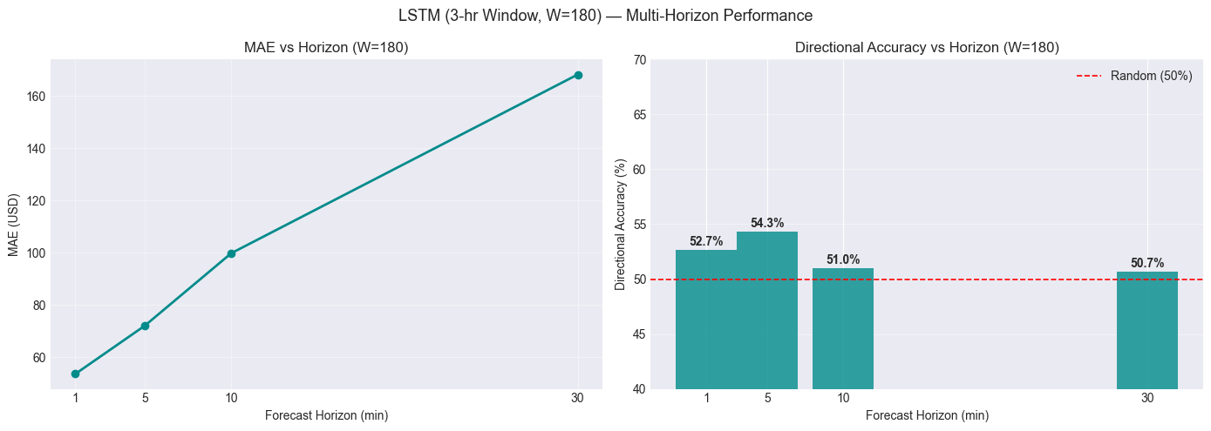
LSTM 3-Hour Window
Used a 3-hour window input, model used previous 180 minutes to predict future bitcoin prices
MAE got increased from 53.61 to 168.24
The model is better for short-term horizons then long-term horizons
Due to high volatility of bitcoin longer horizon predictions becomes difficult.
Above the red line is shows model has a real predictive signal for direction.
H | MAE($) | DirACC(%)
1 | 53.61 | 52.7
5 | 72.02 | 54.3
10 | 99.82 | 51.0
30 | 168.24 | 50.7

Slide 19
Multi-Day forecast
Each model evaluated across different days
To check the model stability over longer periods multi-day forecast was added
Used 1-min bitcoin data also used rolling 1 step ahead for real-time prediction
Across all ARIMA archived lowest MAE
ARIMA captures linear patterns and short-term prices Hybrid is designed to capture linear and non-linear patterns
MULTI-DAY FORECAST STABILITY: MAE ($) BY EVALUATION WINDOW
Model | Day 2 | Day 5 | Day 10 | Day 15
ARIMA | 35.65 | 32.12 | 31.90 | 30.18
Prophet | 893.69 | 3427.51 | 6044.10 | 8897.93
LSTM(Univariate) | 70.80 | 63.76 | 64.22 | 64.52
LSTM(Multivariate) | 78.80 | 71.19 | 71.14 | 68.91
Hybrid | 35.66 | 32.15 | 31.93 | 30.21

Slide 20
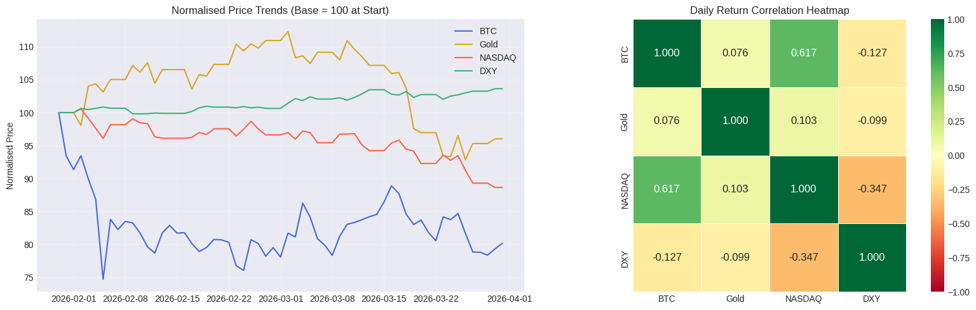
Cross-Market Analysis
This analysis is to check the external market indicators will help bitcoin forecasting
Data resampled to daily close price and aligned with GOLD,NASDAQ and DXY
NASDAQ had a strong correlation with BTC 0.617
Gold showed a weak correlation and USD resulted in negative correlation
BTC and NASDAQ showed positive relationship among them

Slide 21
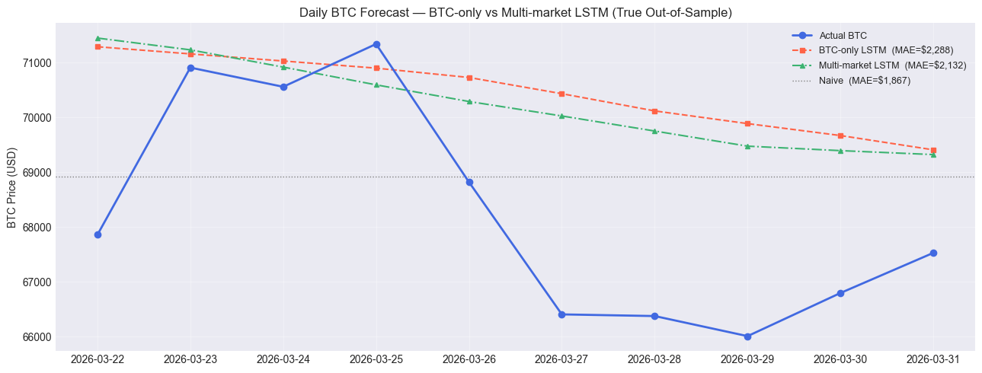
Multi-Market forecasting result
Tested Multi-market daily LSTM BTC + Gold + NASDAQ + DXY
Trained two models BTC-only LSTM and Multi-market model
BTC-only LSTM MAE: $2,288.89 .12
Naive baseline MAE: $1,867.11
Multi-market LSTM MAE: $2,131
Overall, multi-market analysis shows the bitcoin forecasting can improve when the external market indicators are added.

Slide 22
Conclusion
This project compares five forecasting models for bitcoin price prediction
ARIMA(2,1,2) results lower error values among all other models
LSTM models followed trends but resulted in higher error values
Multi-Horizon analysis shows as horizon increases error values are increasing
External market indicators improves bitcoin predictions compared with BTC only LSTM
Overall, this analysis describes that bitcoin price prediction is challenging and ARIMA remain best for short-term predictions

Slide 23
Thank You

